Slide 1
How to generate polygenic risk score
Yunsung Lee
Norwegian Institute of Public Health

Slide 2
What is PRS?

Slide 3
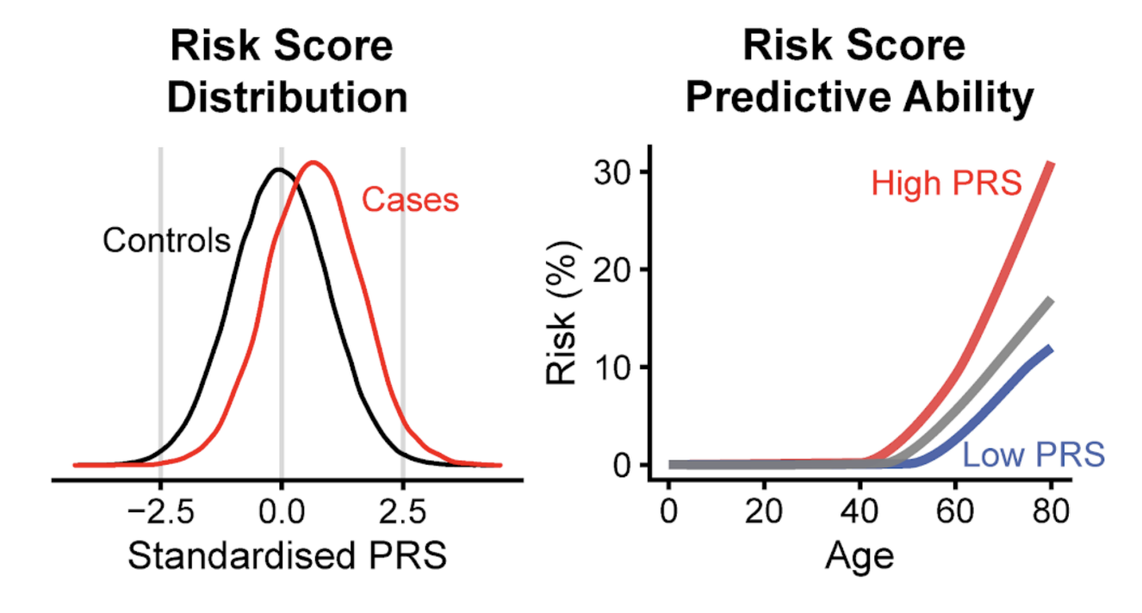
How to use PRS?
Or Mendelian randomization for causal inference

Slide 4
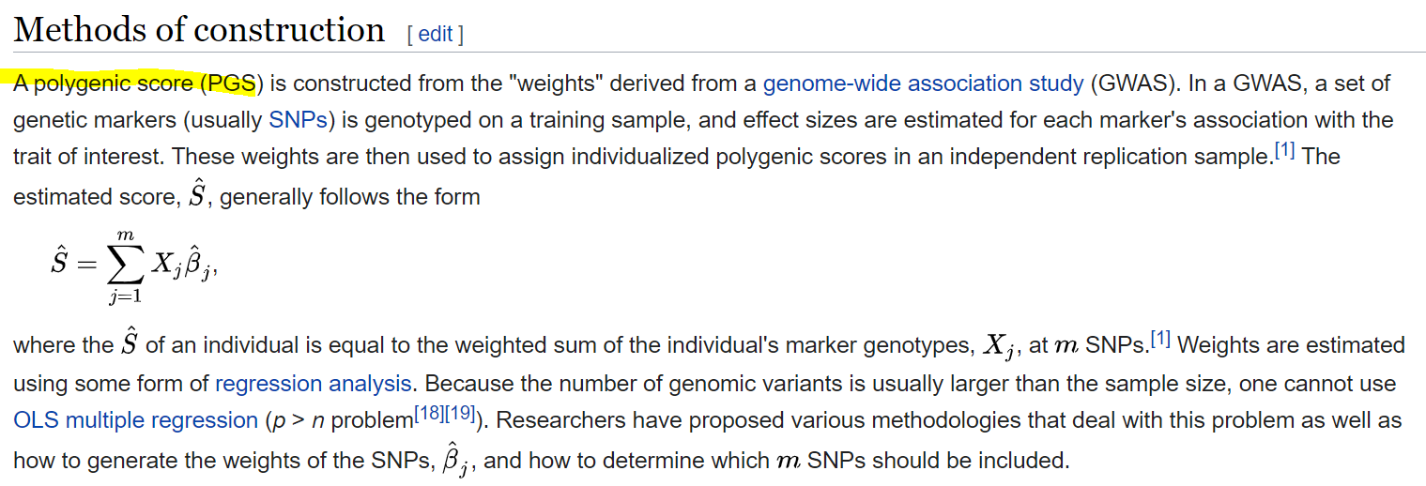
Let’s generate PRS

Slide 5
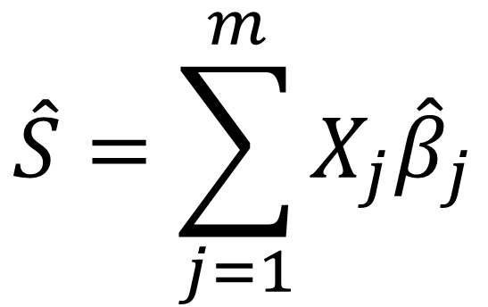
Let’s generate PRS
weight
GWAS summary statistics
$$\hat{S}=\sum_{j=1}^{m}{X_{j}{\hat{β}}_{j}}$$
# of effect allele at jth SNP.
Individual level genotypic data

Slide 6
How to fetch GWAS summary statistics?
Height – GIANT consortium
https://portals.broadinstitute.org/collaboration/giant/index.php/GIANT_consortium_data_files
Lipoprotein A – Burgess et al. 2018
https://jamanetwork.com/journals/jamacardiology/fullarticle/2685216
Supplementary file: eTable 3

Slide 7
How to extract individual level genotypic (imputed) data?
1. I recommend a Linux machine with sufficient cores and RAM. -> TSD, HUNT cloud, or NREC
2. You need software
plink: download the zip file, unzip it, and execute the plink.
e.g., wget http://s3.amazonaws.com/plink1-assets/plink_linux_x86_64_20201019.zip
unzip plink_linux_x86_64_20201019.zip
./plink or /home/ubuntu/plink
bcftools: sudo apt-get install bcftools (bash command)
PreCise: install r-base, download PreCise, and execute PreCise.R file using Rscript.
3. You need genotypic (preferably imputed) data.
https://www.internationalgenome.org/category/vcf/
ftp://ftp.1000genomes.ebi.ac.uk/vol1/ftp/phase1/analysis_results/integrated_call_sets/

Slide 8
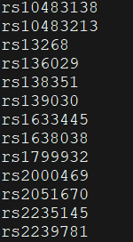
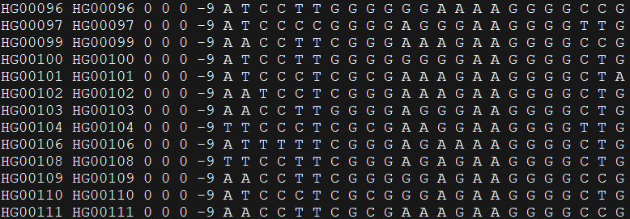
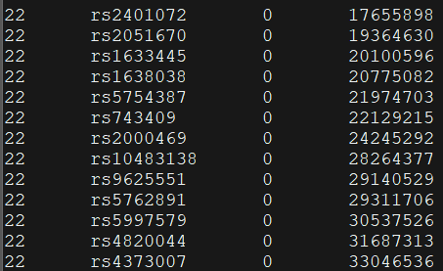
How to extract individual level genotypic (imputed) data?
1. When xx.bim, xx.bed, xx.fam files are given
plink \
--bfile 22 \
--extract SNP_list.txt \
--recode --out 22
rs2051670
rs2401072
ped file
map file

Slide 9
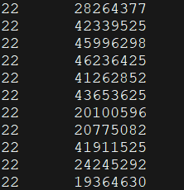
How to extract individual level genotypic (imputed) data?
1. When xx.vcf files are given
bcftools query \
-f '%CHROM\\_%POS[\\t%SAMPLE=%TGT]\\n' \
/home/ubuntu/GENESTAT/22.vcf.gz \
-R /home/ubuntu/GENESTAT/list22.txt > /home/ubuntu/GENESTAT/data22.txt

Slide 10
How to calculate PRS?
(-0.0082) x 1 ------
(-0.0098) x 0 ------
(0.0101) x 2 -----
rowsum
(-0.0082) x 2 ------
(-0.0098) x 0 ------
(0.0101) x 2 -----
rowsum

Slide 11
You can download these slides, R code, and example data from the following link:
https://drive.google.com/drive/folders/1MUddC8SBU4G8yH-ECDNqczkPIkkXY_1-?usp=sharing
Recommend website: https://choishingwan.github.io/PRS-Tutorial/cal_prs/

Slide 12
Questions?

Slide 13
Please download relevant files
for tomorrow’s lecture
https://uio-my.sharepoint.com/:f:/g/personal/yunsungl_uio_no/EqHDAa_4yWdHjuOsvU_KuNwBRcWxnr1ZOBUJ-hDwRyy5Sg?e=AiXPcg

