Slide 1
Epigenetic clocks
Yunsung Lee
Norwegian Institute of Public Health

Slide 3
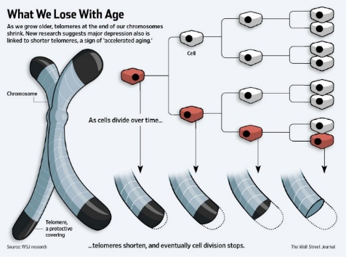
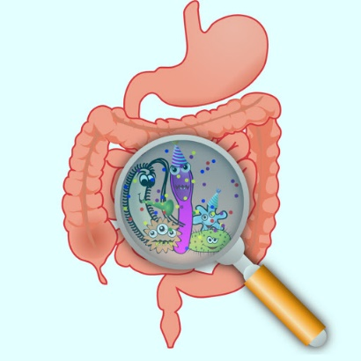
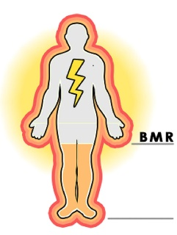
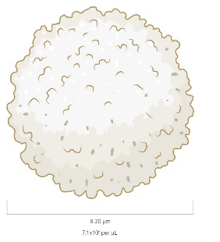
Measures how many times you have revolved around the sun.
Cannot be reversed or altered.
Measures how well your physiological systems are functioning.
Highly correlated with chronological age.
Possibly reversed through therapeutic interventions.

Slide 4
Measures how many times you have revolved around the sun.
Cannot be reversed or altered.
Measures how well your physiological systems are functioning.
Highly correlated with chronological age.
Possibly reversed through therapeutic interventions.
Notes:
DNAm -> Gene switches. 28 millions.
They turn on or off our genes according to age and life style

Slide 5
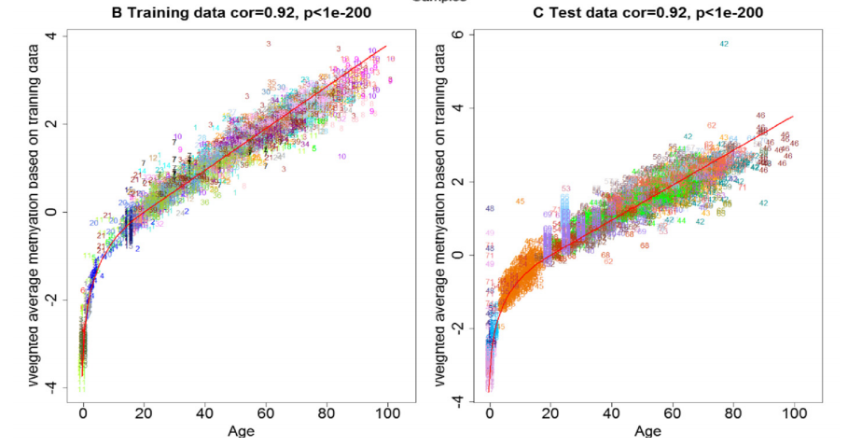
Age acceleration
Age deceleration

Slide 6
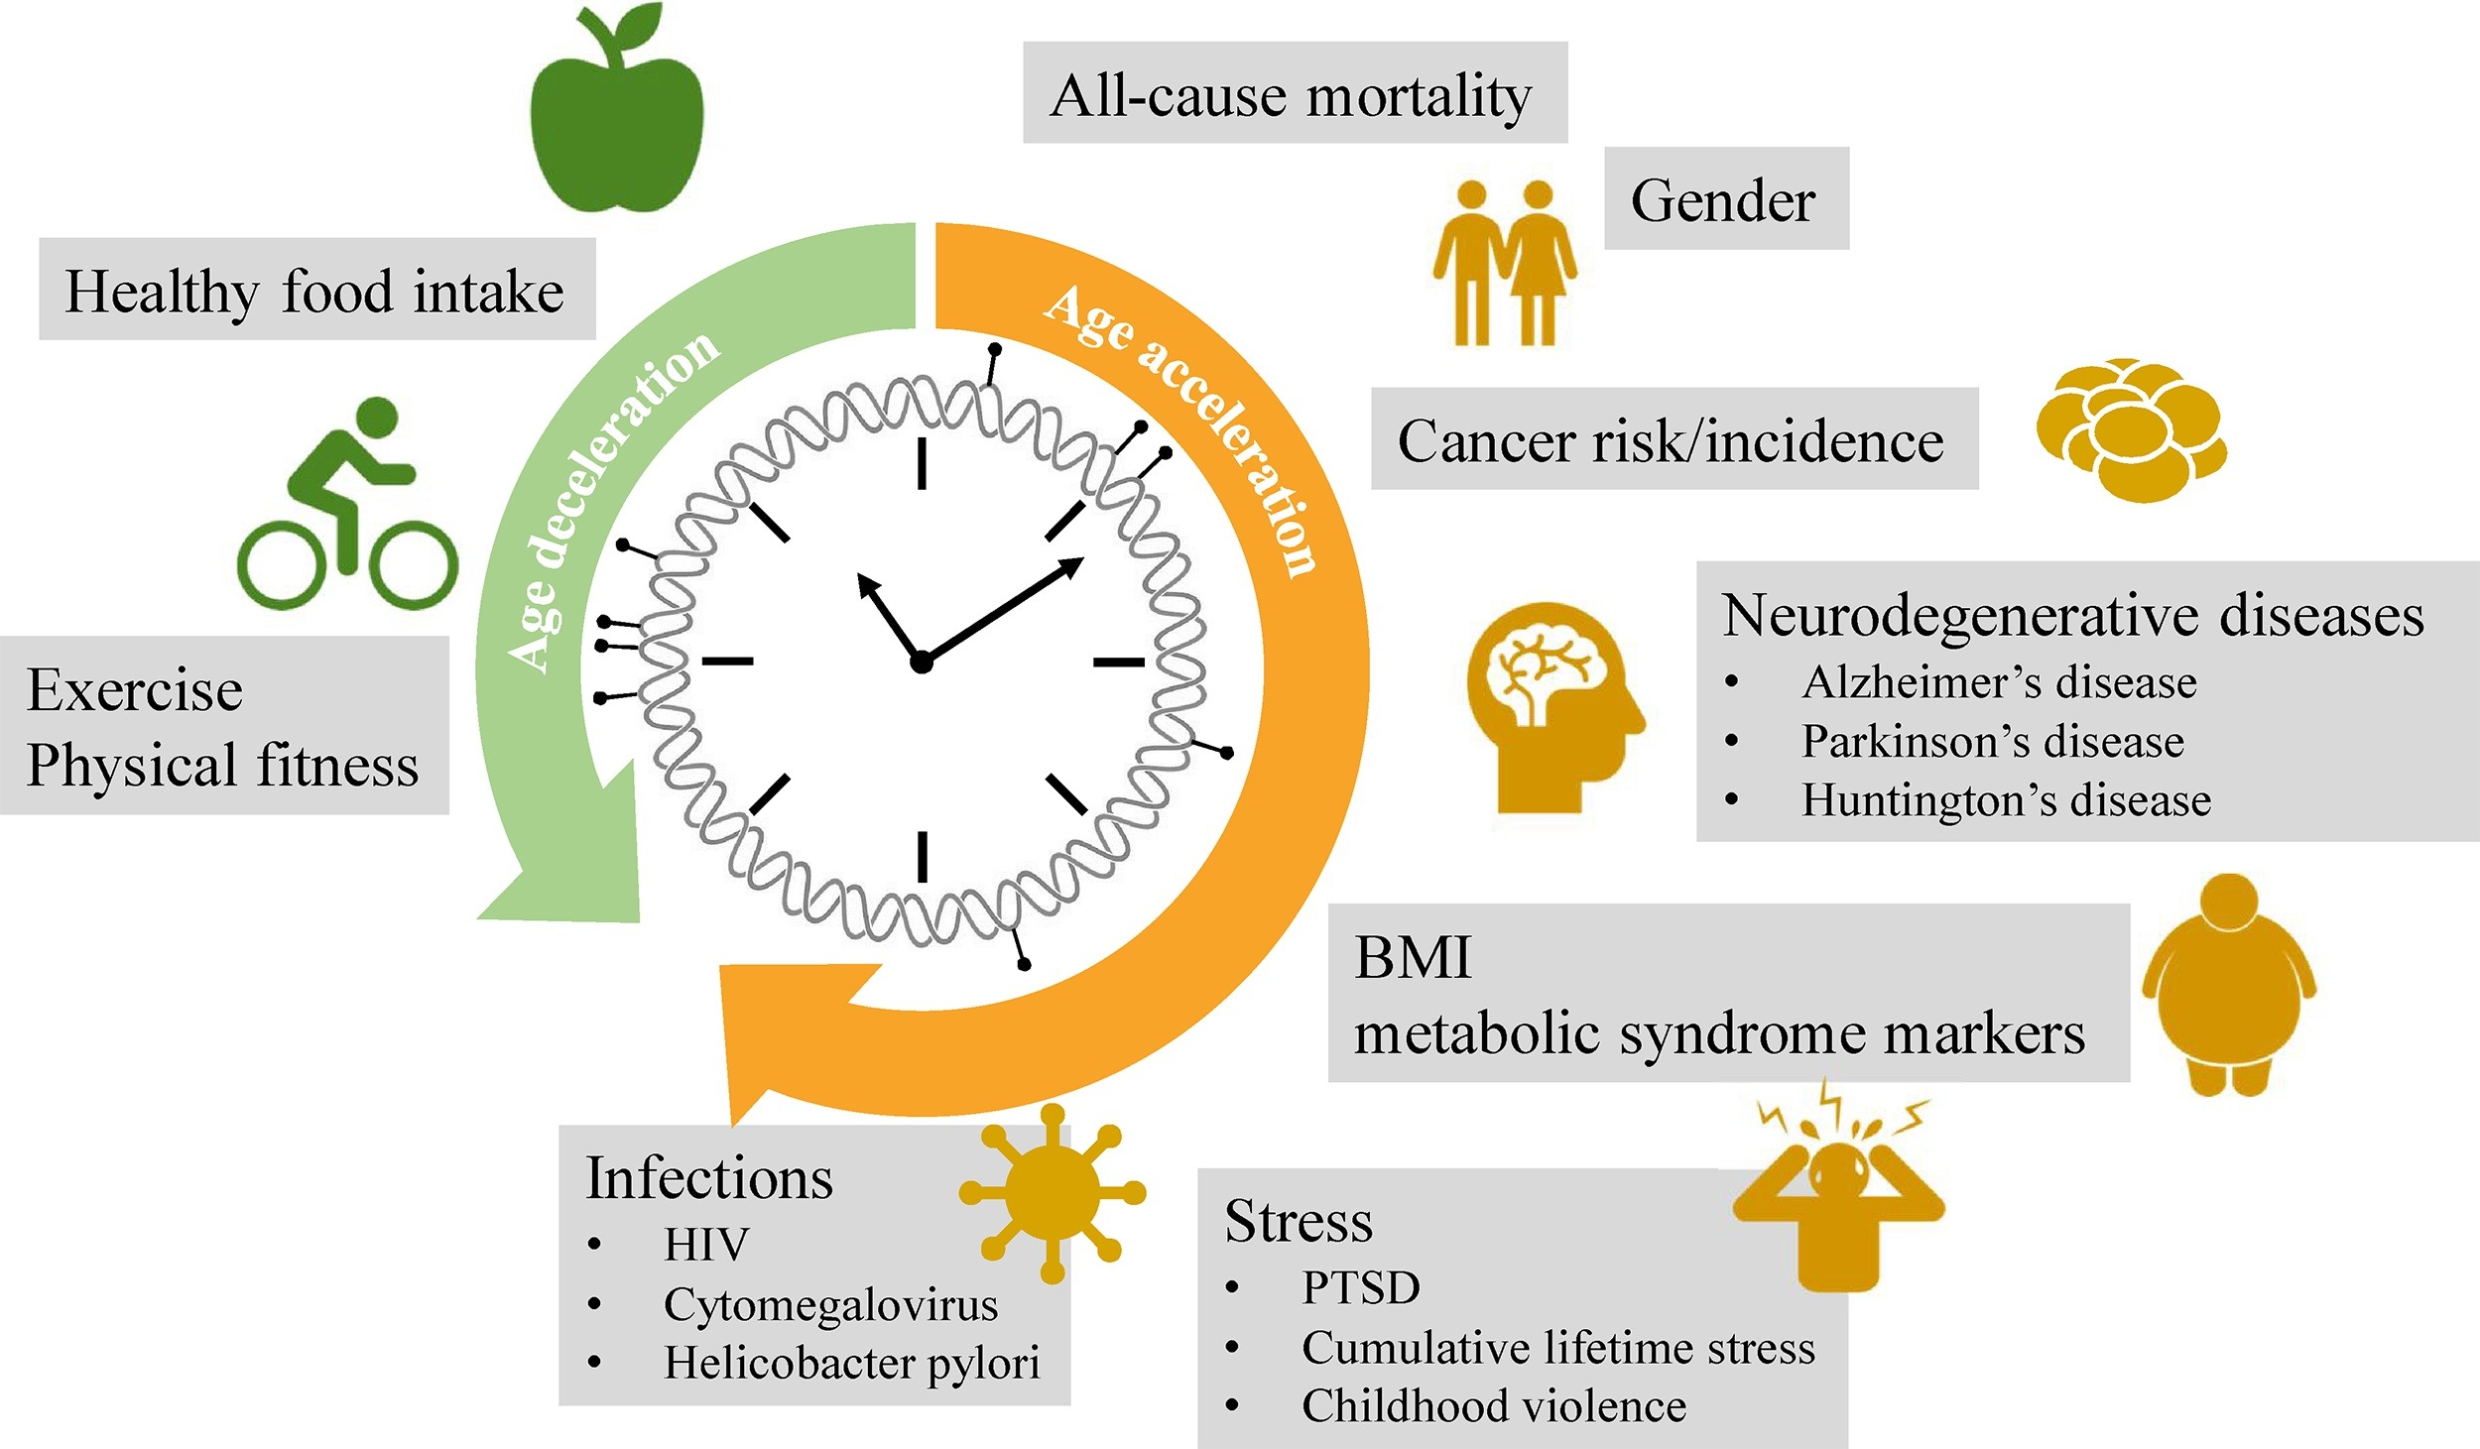
Source: Declerck, Ken, and Wim Vanden Berghe. "Back to the future: epigenetic clock plasticity towards healthy aging." Mechanisms of Ageing and Development 174 (2018): 18-29.

Slide 7
How do epigenetic clocks look like?
How did researchers develop them?
Can we make our own?

Slide 8
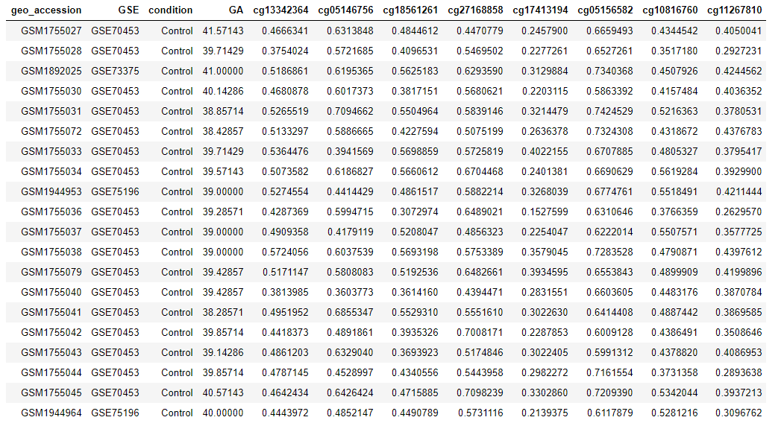
Snapshot of DNA methylation data
Age
Illustrative only

Slide 9
Snapshot of DNA methylation data
Age
Training
$$Y=$$
$$X_{1}β_{1 }$$
+
$$ε$$
+
$$X_{2}β_{2 }$$
+
$$X_{3}β_{3 }$$
+
$$X_{4}β_{4 }$$
… … … … … …
+
$$β_{0 }$$
$$\hat{Y}=$$
$$X_{1}{\hat{β}}_{1 }$$
+
$$X_{2}{\hat{β}}_{2 }$$
+
$$X_{3}{\hat{β}}_{3 }$$
+
$$X_{4}{\hat{β}}_{4 }$$
… … … … … …
+
$${\hat{β}}_{0 }$$
Test
$\hat{Y}$ vs $Y$

Slide 10
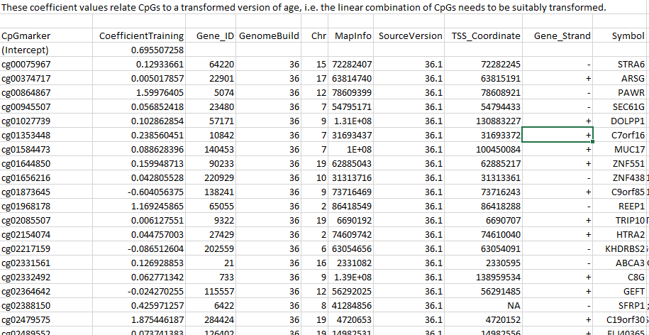
Usually in Supplementary Files

Slide 11
Let’s find Levine et al.’s PhenoAge clock.
Basically, google it.
Check out Horvath’s online calculator
- Again, google it.

Slide 12
Then, how did researchers develop them?

Slide 13
Snapshot of DNA methylation data
Age
Training
$$Y=$$
$$X_{1}β_{1 }$$
+
$$ε$$
+
$$X_{2}β_{2 }$$
+
$$X_{3}β_{3 }$$
+
$$X_{4}β_{4 }$$
… … … … … …
+
$$β_{0 }$$
$$\hat{Y}=$$
$$X_{1}{\hat{β}}_{1 }$$
+
$$X_{2}{\hat{β}}_{2 }$$
+
$$X_{3}{\hat{β}}_{3 }$$
+
$$X_{4}{\hat{β}}_{4 }$$
… … … … … …
+
$${\hat{β}}_{0 }$$
Test
$\hat{Y}$ vs $Y$

Slide 14
A simple and easy solution
Why don’t we regress the outcome (Y) on all predictors (X1 + X2 + .. )?
For example,
Age ← cg00000029 + cg00000109 + cg00000165 + cg00000236 +
cg14817997 + cg26928153 + cg16269199 + cg13869341 + cg14008030 + cg12045430 +
cg20826792 + cg20253340 + cg02404219 + cg21870274 + cg03130891 + cg04098293 +
cg16382250 + cg24335620 + cg22463138 + cg16162899 + cg01803908 + cg17149495 +
cg22802167 + cg24669183 + cg17308840 + cg17866181
+ …… +
cg25018832 + cg26679879 + cg22519184 + cg11894324 + cg24159721 + cg02288058 +
cg15174812 + cg12376350 + cg08477687 + cg00034556 + cg00645010 + cg15394630 +
cg05001044 + cg03344490 + cg17501828 + cg11330075 + cg23917638 + cg18024856 +
cg18761878 + cg27534567 + cg08858441 + cg03348902 + cg01070250 + cg21996134 +
cg07264491 + cg01577251 + cg13128577 + cg15560884 + cg10037654 + cg14057946 +
cg11422233 + cg16047670 + cg18263059 + cg01014490 + cg11731845 + cg04231937 +
cg04496485 + cg24063007 + cg11380914 + cg10692041 + cg23904010

Slide 15
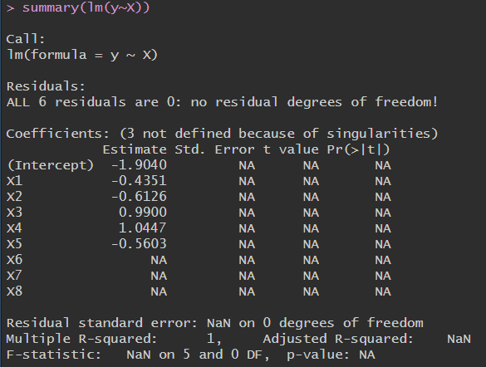
No, we can’t – because of the curse of dimensionality (too many columns)
We cannot regress “Y” on “X1 + X2 + … + X8”
Because, we have more predictors (p = 8) than
sample size (n = 6).
In an ordinary linear regression,
$$\hat{β}= argmin_{β}\sum_{i=1}^{n}{{\left(Y_{i}−Xβ\right)}^{2}}$$
$$\hat{β}={\left(X^{T}X\right)}^{−1}X^{T}Y$$
We cannot calculate ${\left(X^{T}X\right)}^{−1}$ due to …

Slide 16
ELASTIC NET REGRESSION
Dimension reduction, shrinkage, regularization, penalty term..
$$\hat{β}= argmin_{β}\sum_{i=1}^{n}{{\left(Y_{i}−Xβ\right)}^{2}+λ\left[(1−α)\sum_{j=1}^{p}{β_{j}^{2}}+α\sum_{j=1}^{p}{{|β}_{j}|}\right]}$$
Pick!
Pick!
…
Age

Slide 17
Then, how do we determine $λ$ or $α$?
$$\hat{β}= argmin_{β}\sum_{i=1}^{n}{{\left(Y_{i}−Xβ\right)}^{2}+λ\left[(1−α)\sum_{j=1}^{p}{β_{j}^{2}}+α\sum_{j=1}^{p}{{|β}_{j}|}\right]}$$
Pick!
Pick!
…
…
Age
…

Slide 18
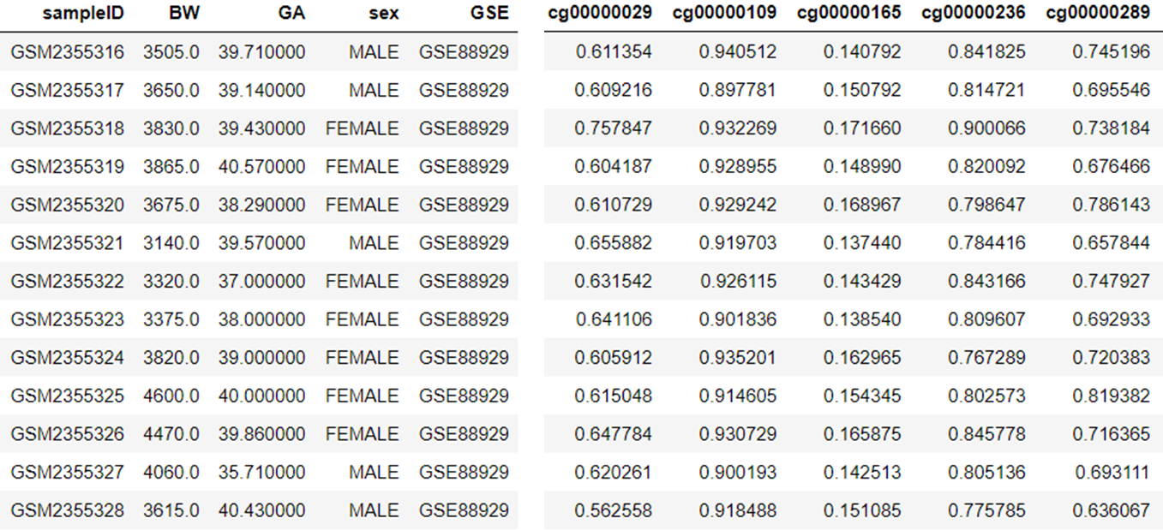
Then, how do we determine $λ$ or $α$?
K-fold cross validation
$$\hat{β}= argmin_{β}\sum_{i=1}^{n}{{\left(Y_{i}−Xβ\right)}^{2}+λ\left[(1−α)\sum_{j=1}^{p}{β_{j}^{2}}+α\sum_{j=1}^{p}{{|β}_{j}|}\right]}$$
…
$λ=0.01, α=0.$1
TRAIN
Compute MSE
…

Slide 19
Then, how do we determine $λ$ or $α$?
K-fold cross validation
$$\hat{β}= argmin_{β}\sum_{i=1}^{n}{{\left(Y_{i}−Xβ\right)}^{2}+λ\left[(1−α)\sum_{j=1}^{p}{β_{j}^{2}}+α\sum_{j=1}^{p}{{|β}_{j}|}\right]}$$
…
Compute MSE
$λ=0.01, α=0.$1
TRAIN
Compute MSE
…

Slide 20
Then, how do we determine $λ$ or $α$?
K-fold cross validation
$$\hat{β}= argmin_{β}\sum_{i=1}^{n}{{\left(Y_{i}−Xβ\right)}^{2}+λ\left[(1−α)\sum_{j=1}^{p}{β_{j}^{2}}+α\sum_{j=1}^{p}{{|β}_{j}|}\right]}$$
…
Compute MSE
$λ=0.01, α=0.$1
TRAIN
…

Slide 21
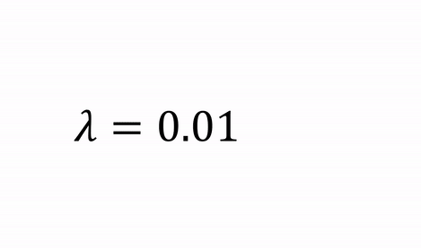
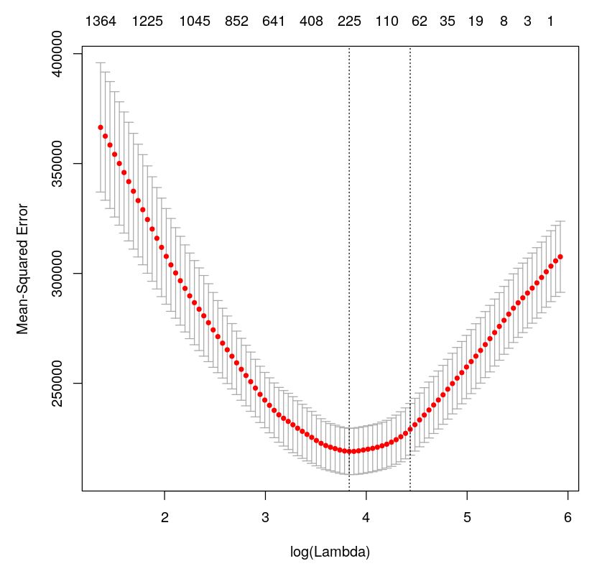
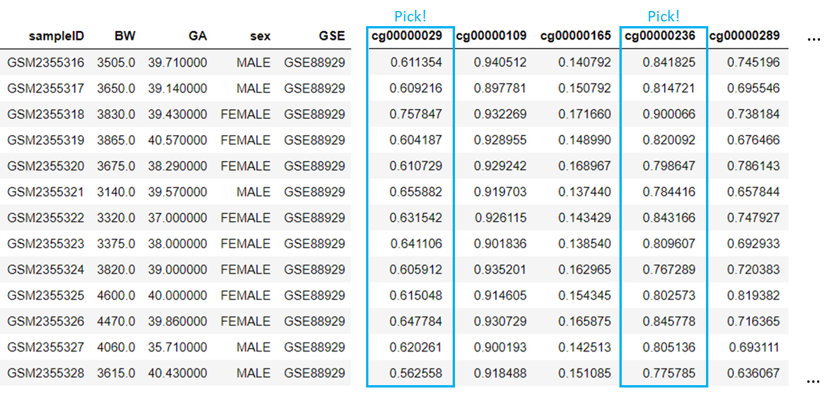
ELASTIC NET REGRESSION of birthweight on DNAm at CpGs
cv.glmnet - R package glmnet
number of selected CpGs out of 450K
that result in minimum MSE

Slide 22
Can we make our own clock?
What do you think we need?

Slide 23
We need DNAm data.
Google NCBI Gene Expression Omnibus
GSE51032 and GSE87571

Slide 24
Let’s get our hands a bit dirty.
Please download
R code and DNAm data
from the following Onedrive storage:
https://drive.google.com/drive/folders/1MUddC8SBU4G8yH-ECDNqczkPIkkXY_1-?usp=sharing

